Slide 1
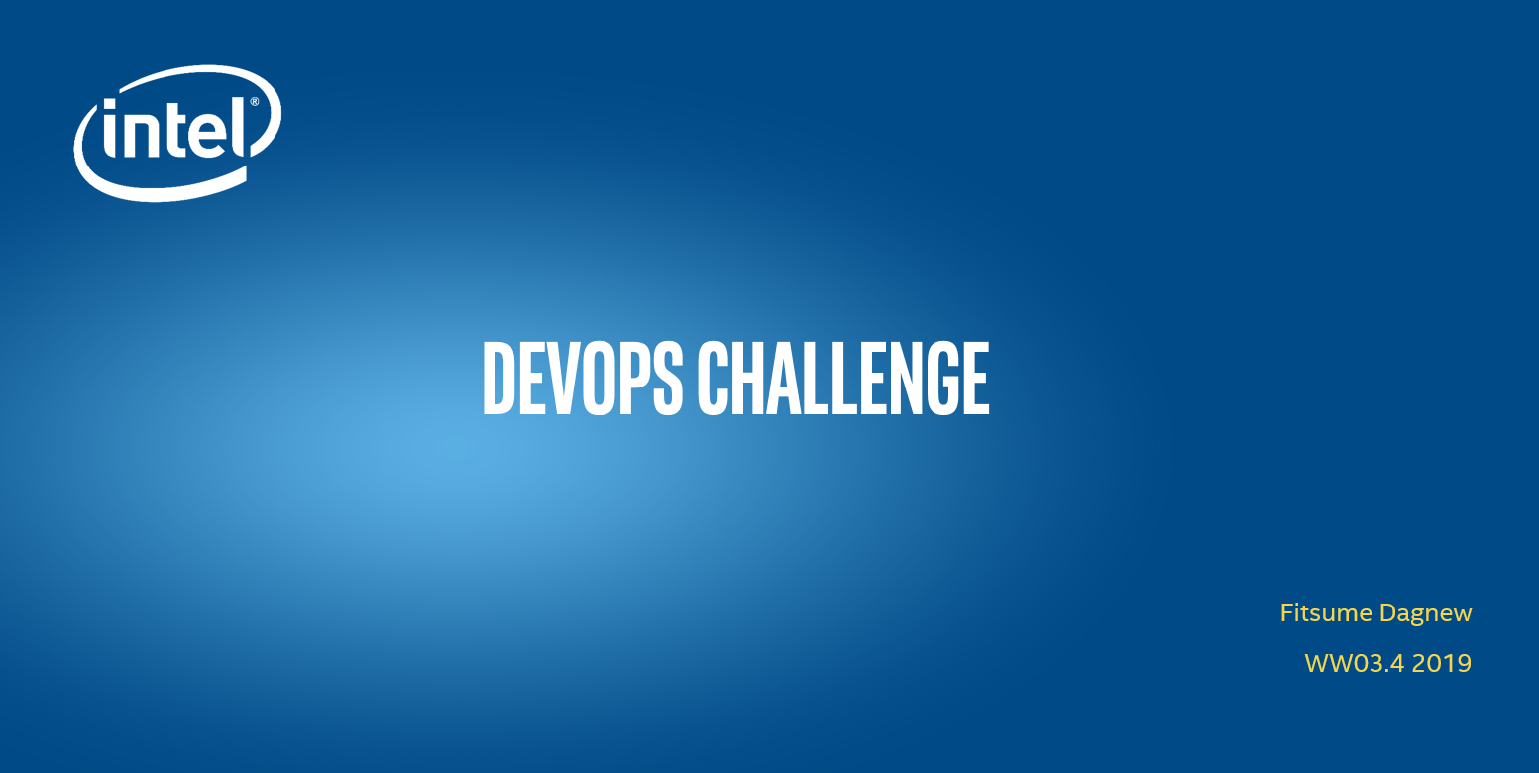

Slide 2
Contents
Challenge Statement
Challenge approach
3) Resources
Architectural Diagram – 1
Architectural Diagram – 2
6) Demo
Q&A?

Slide 3
Challenge Statement
Description Implement a Continuous Delivery strategy for a Cloud-aware Sample web application, on this scenario you’re free to choose the application, what is important here is to showcase requirements described below. In conjunction you’ll be asked to define an architecture for auto testing and deploying the web application when new code changes come to the web application repository. Listed below you will see the general requirements and required cloud capabilities.
General Requirements - A Web application that consumes a database - Application must be hosted in a github repository - Continuous Testing and Deployment for any new code changes requests in Github - Deployed on a Cloud Service Provider of choice (Tier 1 or 2) - Services can be hosted either on VMs or Containers
Cloud Capabilities - Automated Deployment - High Availability or load balancing - Elasticity - Persistent storage - Basic performance/usage metric collection

Slide 4
Challenge approach
General Requirements
1 - A Web application that consumes a database Used a simple php website that takes user input and insert data on mysql database
2 - Application must be hosted in a github repository Application is hosted on github https://github.com/fdagnew/OTCDevOpsChallenge.git
3 - Continuous Testing and Deployment for any new code changes requests in Github
Once a developer push a new code on Github repo, Jenkins jobs will start automatically, a build step on development server then a selenium test on test server will follow. Once the test is successful then the application will be deployed on AWS beanstalk(with Auto scale and ELB). The webpage can be accessed from cloudfront url
4 - Deployed on a Cloud Service Provider of choice (Tier 1 or 2) AWS is used for all the DevOps challenge resources
5 - Services can be hosted either on VMs or Containers The services are hosted on AWS EC2 VMs
Cloud Capabilities
1 - Automated Deployment Upon successful Selenium testing, the website will be deployed to beanstalk
2 - High Availability or load balancing
All resources are created in a single VPC across Azs and the beanstalk infra is created with Autoscale(min 2, max 4) and Load balancing
3 – Elasticity AWS EC2 – we pay what we use
4 - Persistent storage Data is stored in EBS
5 - Basic performance/usage metric collection Cloudwatch

Slide 5
Resources
1) GitHub https://github.com/fdagnew/OTCDevOpsChallenge.git
2) VPC https://us-west-2.console.aws.amazon.com/vpc/home?region=us-west-2#vpcs:sort=tag:Name
2 Public and 2 Private Subnets
2 Route Tables (Public and Private)
An Internet Gateway
A NAT Gateway
An Elastic IP
3) Jenkins URL http://34.210.99.226:8080/
4) EC2 Instances https://us-west-2.console.aws.amazon.com/ec2/v2/home?region=us-west-2#Instances:sort=instanceState
Jenkins Master Server: Public IP 34.210.99.226
Development Slave Server: Public IP 54.191.211.152
Test Slave Server: Public IP 34.221.79.53
Bastion Server: Public IP 52.39.130.160
Beanstalk Web Instance: Private IP 10.0.3.85
Beanstalk Web Instance: Private IP 10.0.4.173
5) AWS MySql RDS: https://us-west-2.console.aws.amazon.com/rds/home?region=us-west-2#databases:
6) Elasticbeanstalk (Environment type: load balancing, auto scaling Instances: 2–4)
https://us-west-2.console.aws.amazon.com/elasticbeanstalk/home?region=us-west-2#/environment/dashboard?applicationName=FitsumeOTC&environmentId=e-2kqwa56y2g
7) Website
Test: http://34.221.79.53/form.php
Production beanstalk: http://fitsumeotc-env-2.dfbp7muumy.us-west-2.elasti
cbeanstalk.com/form.php
Production cloudfront: http://d2ohmkr7w65o21.cloudfront.net/form.php
8) CloudWatch: https://us-west-2.console.aws.amazon.com/cloudwatch/home?region=us-west-2#metricsV2:

Slide 6
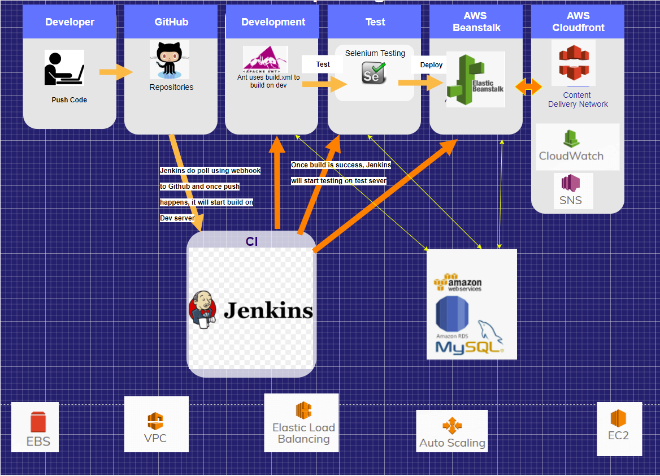
Architectural Diagram – 1

Slide 7
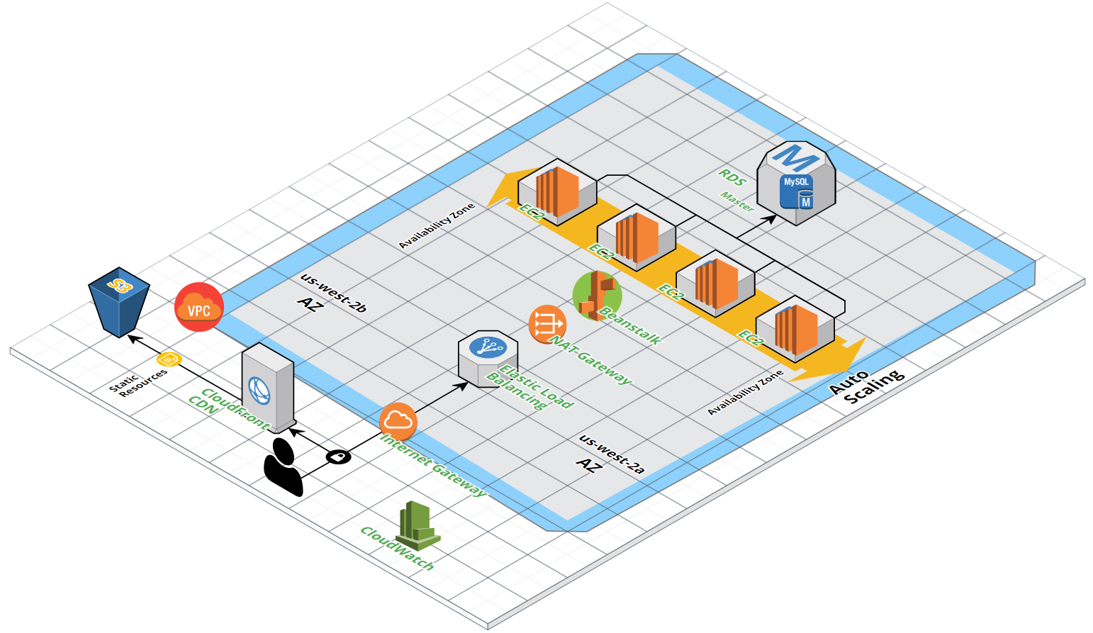
Architectural Diagram – 2

Slide 8
Demo

Slide 9
Q & A

Slide 10
Thank You

